Slide 1

Notes:
https://www.youtube.com/watch?v=VxpxLIuPxLA
Speaker Script:
Welcome, everyone. Today we are conducting a forensic examination of the current market environment through the lens of one of Wall Street's most renowned short sellers, Jim Chanos.
The core thesis here is straightforward yet alarming: we are currently living through what Chanos terms 'The Golden Age of Fraud'. When market euphoria is high and capital is cheap, corporate structural weaknesses and malfeasance are easily hidden behind rising stock prices. However, as capital spending cycles reach their peak and liquidity tightens, these stress fractures inevitably cause the bubble to unravel. Over the next several slides, we will dissect the AI bubble, accounting illusions, deteriorating returns, and how to construct a resilient investment strategy in these market conditions.
Key Talking Points:
Introduction to Jim Chanos’s core thesis on current market conditions.
The structural relationship between financial market euphoria, heavy CAPEX spending, and hidden corporate fraud.
Overview of the presentation roadmap: from broad market valuations to short-selling mechanics and portfolio management.
Podcast Reference & Context:
Chanos explicitly states: "I've dubbed this the golden age of fraud... the harshest prosecutor and the staunchest defense attorney of a company is its stock price. Nobody goes after frauds at all-time highs."

Slide 2
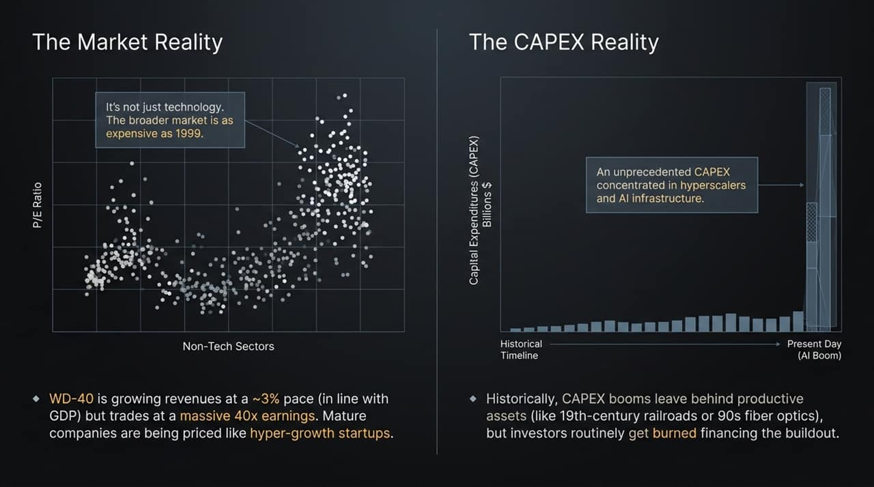
Notes:
Speaker Script:
A common misconception today is that high valuations are isolated to tech giants and AI infrastructure. As this scatter plot illustrates, the broader S&P 500 and non-tech sectors are trading at price-to-earnings multiples comparable to the peak of the 1999 dot-com bubble.
Consider a classic example cited by Chanos: WD-40. This is a mature consumer company growing revenues at roughly 3% per year—essentially matching US GDP growth. Yet, it trades at an extraordinary 40 times earnings. Mature companies across legacy retail, manufacturing, and consumer goods are being priced as if they were hyper-growth tech startups. Much of this is driven by massive passive index investing, where money flows into every S&P 500 constituent regardless of fundamental valuation.
"Looking at the chart on this slide (right hand side), the sheer volume of capital expenditures dedicated to AI infrastructure today is vertically off the charts compared to historical baselines.
History teaches us a consistent lesson regarding massive CAPEX booms. Whether it was the railroad expansion of the 19th century or the telecom and fiber-optic buildout of the late 1990s, these cycles almost always leave behind valuable, productive infrastructure for society. However, the investors who financed the initial buildout routinely get wiped out or suffer severe drawdowns before those long-term benefits materialize. We are seeing that exact same speculative buildout taking place in physical AI assets today.
Key Talking Points:
(Left)
High valuations are not limited to tech/AI companies; the broader market is as expensive as 1999.
The phenomenon of mature, low-growth companies trading at growth-startup multiples (e.g., WD-40).
The role of passive index inflows in pushing up valuations across non-tech sectors.
(Right)
Unprecedented concentration of capital expenditure in hyperscalers and AI infrastructure.
Historical parallels: 19th-century railroads and late 1990s fiber-optic/telecom networks.
The disconnect between long-term societal utility and near-term investor returns.
Podcast Reference & Context:
Chanos highlights: "In 1999 it was the TMT section that had stratospheric valuations... Now we're seeing all kinds of mature companies trading at 40 and 50 times earnings... WD-40 has grown revenues at about a 3% pace... and trades at 40 times earnings."
Chanos points out: "CAPEX booms tend to end badly. They tend to leave behind very productive assets... as they did during the dotcom buildout or the railroad buildout... But investors often get burned along the way in financing that buildout."

Slide 3
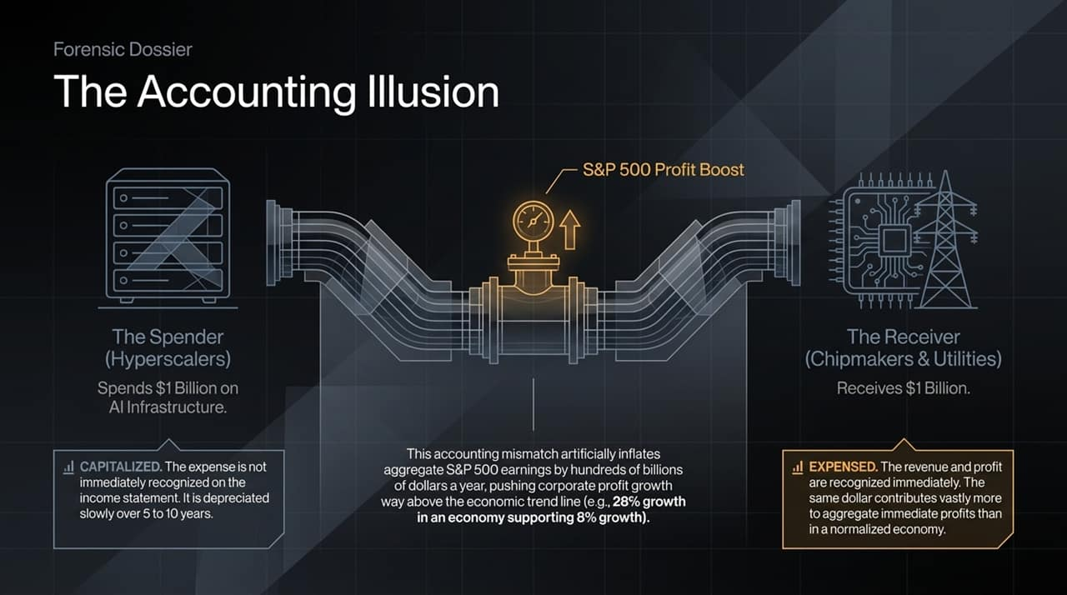
Notes:
Speaker Script:
This slide illustrates one of Chanos's most critical financial forensic observations: the accounting identity mismatch inherent in huge CAPEX booms.
When a hyperscaler spends $1 billion on AI infrastructure (chips, data centers, power), they do not expense that $1 billion on their income statement today. Instead, they capitalize it and depreciate it slowly over 5 to 10 years. However, the receivers of that capital—the chipmakers, hardware suppliers, and utilities—recognize that $1 billion as revenue and profit immediately.
Because the revenue is recognized upfront while the expense is amortized over a decade, aggregate S&P 500 earnings are artificially inflated by hundreds of billions of dollars today. This is why corporate profit growth appears to be soaring at ~28% in an economy running at ~8% nominal growth.
Key Talking Points:
The structural accounting mismatch between CAPEX spenders and vendor receivers.
How capitalization vs. immediate revenue recognition artificially inflates aggregate S&P 500 earnings.
Distinguishing between real economic growth (~8%) and inflated corporate profit growth (~28%).
Podcast Reference & Context:
Chanos explains: "We have an accounting identity problem... the companies spending the money do not expense immediately... It's capitalized and depreciated over 5 to 10 years. The companies receiving that money... receive it in revenues and profits immediately... That's why S&P profits have taken off."

Slide 4
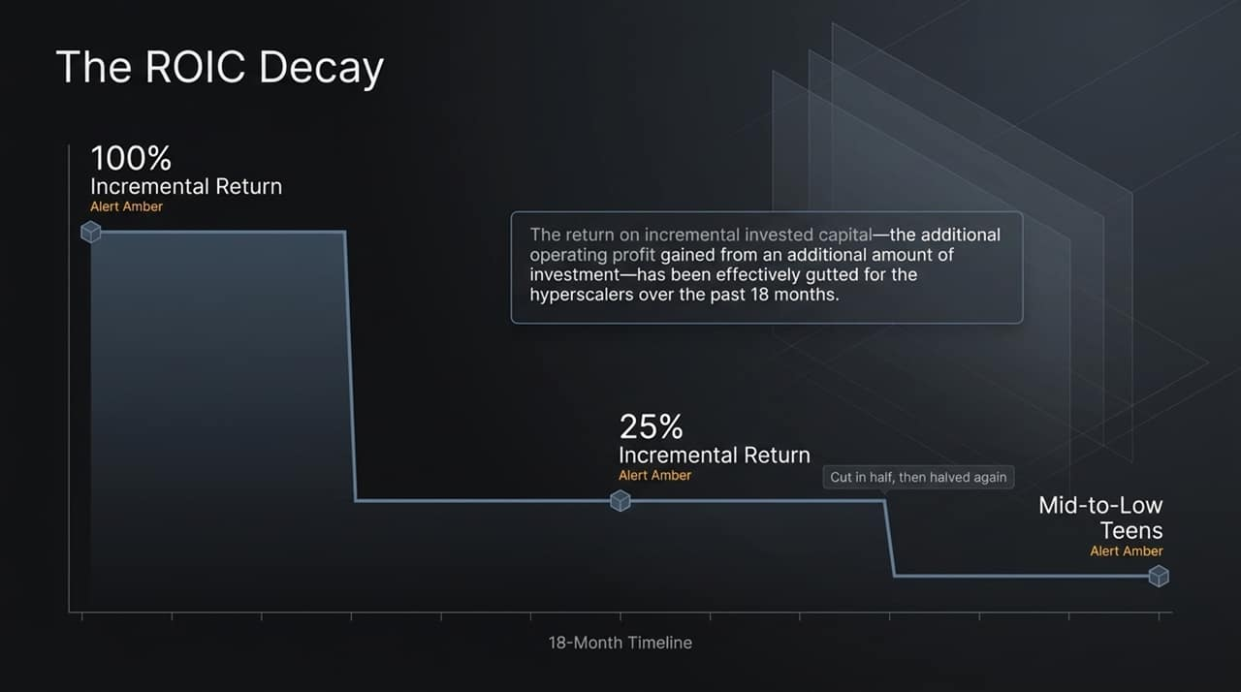
Notes:
Speaker Script:
While revenues and headlines look strong, underlying capital efficiency is deteriorating rapidly. Return on Incremental Invested Capital measures how much additional operating profit a company generates for every new dollar invested.
Over the past 18 months, ROIC for the major hyperscalers has suffered a steep decline. Capital that was previously yielding 100% incremental returns saw those returns cut to 25%, and in several cases into the mid-to-low teens. When return on new capital drops this quickly, it serves as an early amber alert that companies are over-investing relative to actual monetizable demand.
Key Talking Points:
Definition of Return on Incremental Invested Capital (ROIC).
The rapid decay of hyperscaler incremental returns over the past 18 months (from 100% to mid-to-low teens).
Implications for big-tech capital allocation.
Podcast Reference & Context:
Chanos notes: "Most of the return on incremental invested capital... has been pretty much cut in half for the hyperscalers over the past year and a half... Companies earning 100% incrementally are now earning 25%, and a couple are earning in the teens."

Slide 5
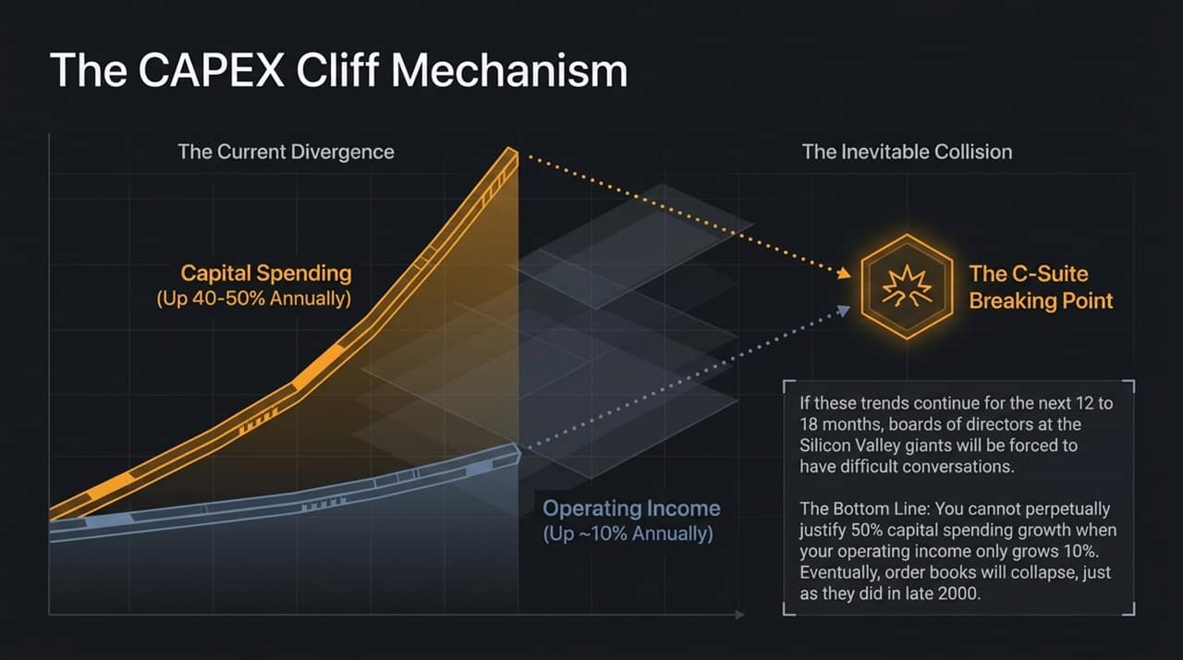
Notes:
Speaker Script:
Here we look at the mathematical wall tech companies are heading toward. Capital spending among major AI players is growing at 40% to 50% year-over-year, while operating income is growing at only around 10%.
You cannot perpetually increase capital expenditure at 50% when your underlying operating profits only grow at 10%. Over the next 12 to 18 months, corporate boards will face intense pressure to justify this spend. Just as in late 2000—when telecom and tech companies realized they needed 2,000 routers instead of 10,000 and canceled orders overnight—a pullback in hyperscaler CAPEX will cause order books across the entire AI ecosystem to collapse.
Key Talking Points:
Divergence between capital spending growth (40–50% annually) and operating income growth (~10% annually).
The upcoming C-suite and Board of Directors breaking point (12–18 month horizon).
Historical precedent: The late-2000 collapse in order books.
Podcast Reference & Context:
Chanos argues: "You can't keep perpetually justifying growing your capital spending 40–50% a year if your operating income is only growing 10%... Eventually, order books will collapse, just as they did in late 2000."

Slide 6
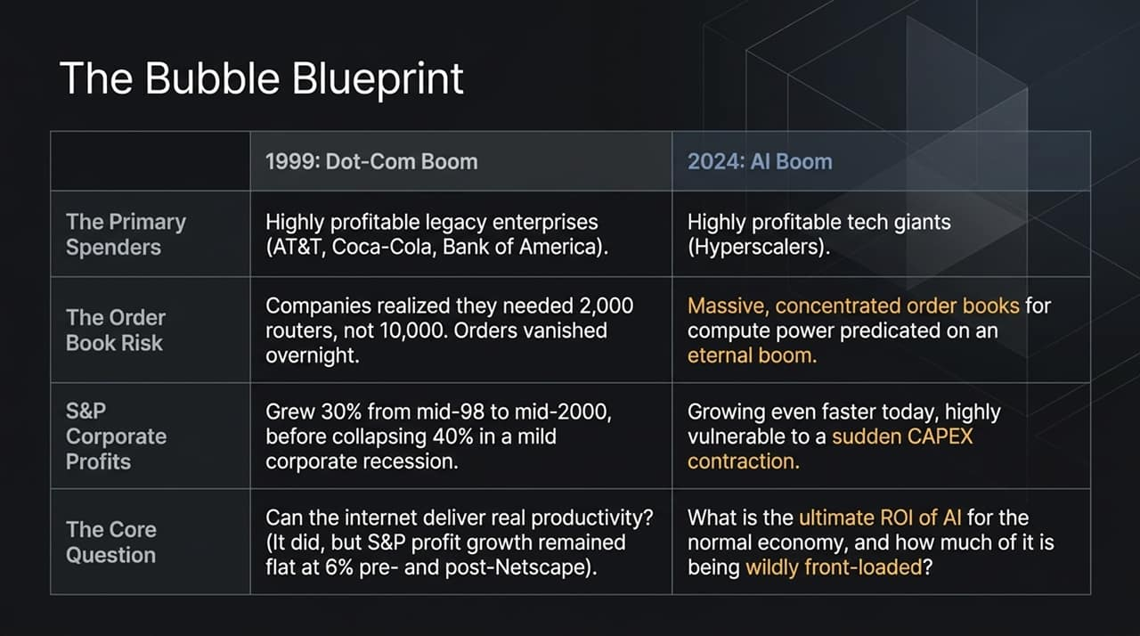
Notes:
Speaker Script:
Comparing the current boom to 1999 reveals key structural similarities and differences. In 1999, spending was led by legacy giants (AT&T, Coca-Cola) networking their infrastructure; today, spending is hyper-concentrated in tech hyperscalers.
The key takeaway here concerns long-term economic productivity. Netscape launched in the mid-90s and revolutionized the world. Yet, S&P 500 profit growth averaged 6% annually in the decade before Netscape and exactly 6% annually in the decade after. While transformative tech creates huge individual winners and losers, it does not magically double baseline economic productivity across the board. The core question today is how much of AI's ultimate ROI is being wildly front-loaded right now.
Key Talking Points:
Comparison of primary spenders, order book risks, and corporate profit trajectories.
Historical lesson: Internet delivered real productivity, but broad S&P profit growth stayed at 6% pre- and post-Netscape.
The fundamental question around AI's ultimate ROI for the general economy.
Podcast Reference & Context:
Chanos notes: "S&P profits grew 6% per annum in the decade before Netscape, and 6% per annum in the decade after... For all the wondermen of the internet, you wouldn't have really noticed it in aggregate economic statistics. The question is what will AI bring in real productivity?"

Slide 7
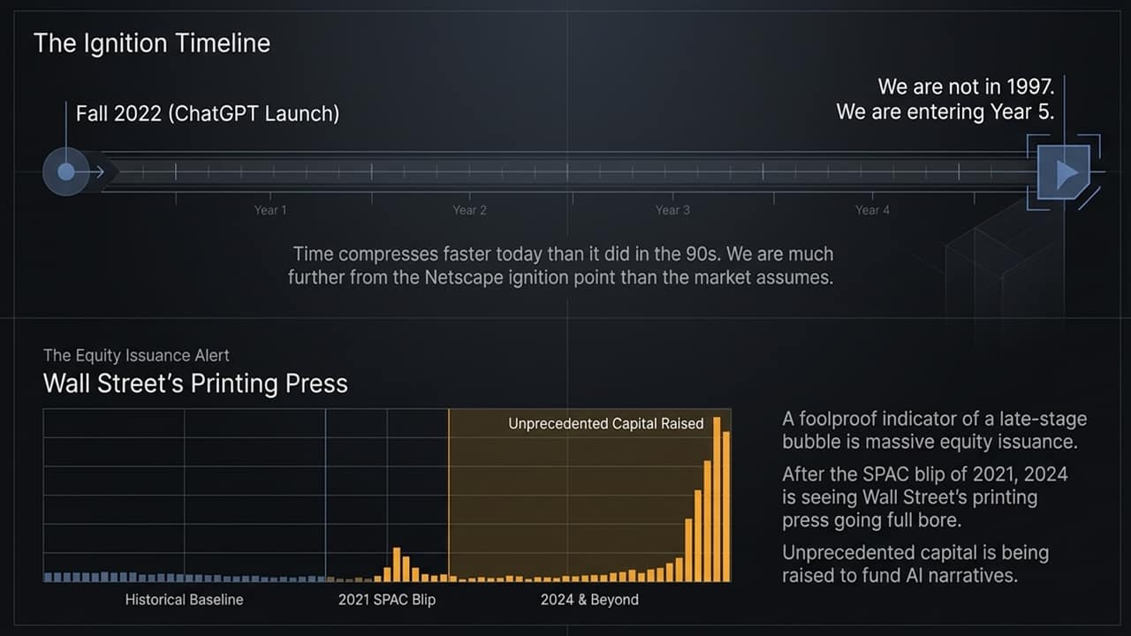
Notes:
Speaker Script:
Many market commentators argue that if ChatGPT launched in late 2022, we are only in '1997' of the tech cycle. Chanos strongly rejects this notion. Time and information flow move far faster today than 30 years ago. We are entering Year 4 or 5 of this cycle, putting us much closer to late 1999.
The single most foolproof quantitative indicator of a late-stage bubble is massive equity issuance. Wall Street operates its own printing press when market euphoria hits its peak. Following the SPAC wave of 2021, we are now seeing record capital raises, secondary offerings, and private market conversions designed to monetize AI narratives while investor appetite remains high.
Key Talking Points:
Timeline compression: Entering Year 4/5 post-ChatGPT launch (Fall 2022).
Massive equity issuance as a foolproof indicator of late-stage bubbles.
Comparing the 2021 SPAC surge to current record equity issuance.
Podcast Reference & Context:
Chanos states: "ChatGPT was fall of 2022. So we're now entering the fifth year... There's one indicator that has been foolproof: equity issuance... Wall Street's printing press is now going full bore."

Slide 8
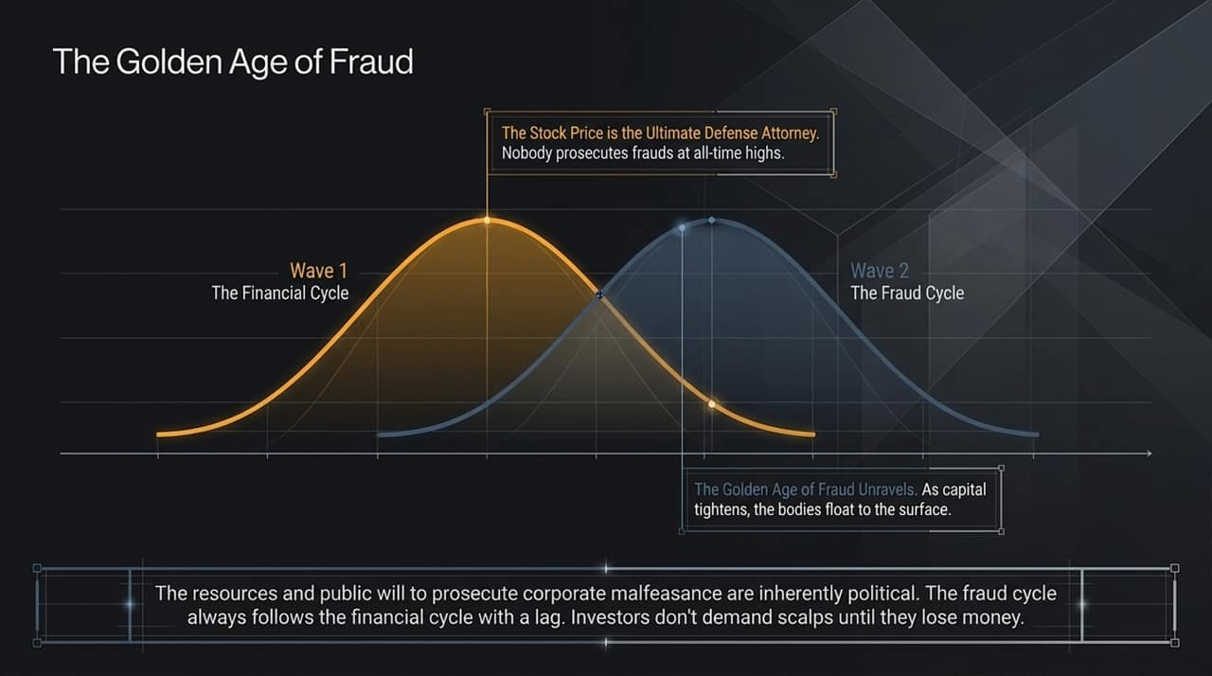
Notes:
Speaker Script:
This diagram outlines the mechanics behind the title of our dossier. The fraud cycle always lags behind the financial cycle.
During Wave 1, when stock prices hit all-time highs, stock price acts as the ultimate defense attorney. Regulators, board members, and investors lack the political will or desire to investigate lucrative companies when everyone is making money.
It is only when Wave 2 arrives—when liquidity dries up and market prices fall—that the 'bodies float to the surface'. Regulators and public prosecutors only demand corporate scalps after retail and institutional investors suffer real losses. The malfeasance occurring today will only be exposed once the tide recedes.
Key Talking Points:
The natural lag between the financial market cycle (Wave 1) and the fraud revelation cycle (Wave 2).
Political nature of corporate fraud prosecution.
Why frauds are uncovered only during down-cycles when capital tightens.
Podcast Reference & Context:
Chanos states: "The fraud cycle follows the financial cycle with a lag... Nobody goes after frauds at all-time highs. The resources and public will to prosecute corporate malfeasance are inherently political."

Slide 9
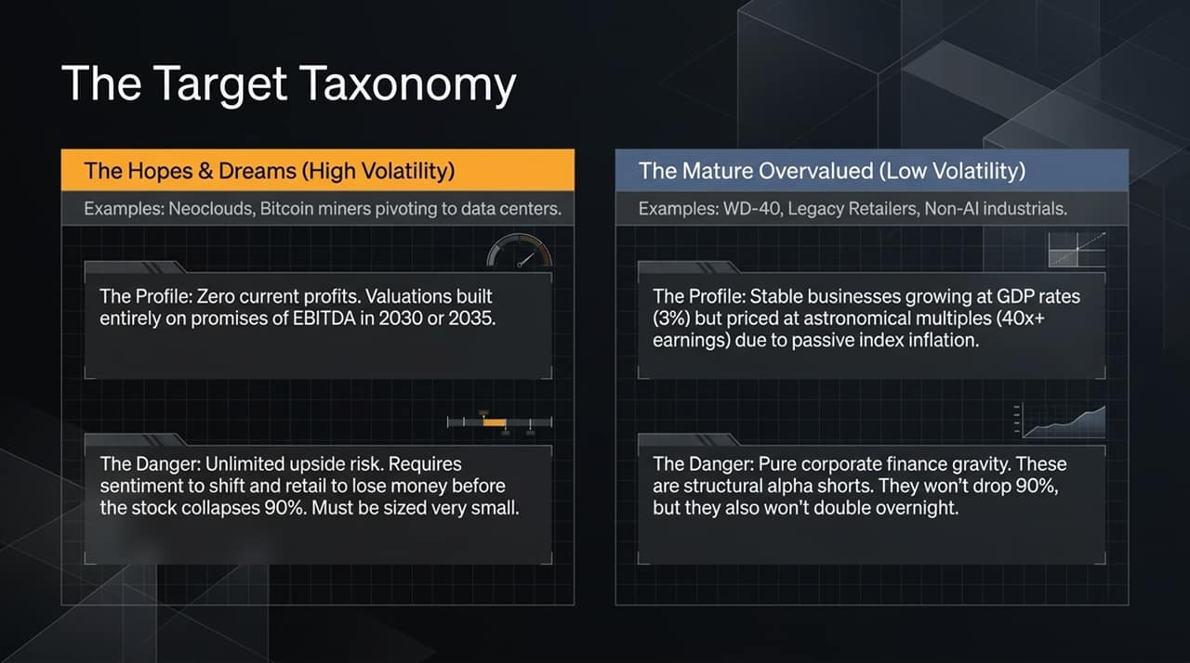
Notes:
Speaker Script:
"In executing a disciplined short-selling strategy, Chanos divides overvalued targets into two distinct buckets:
The Hopes & Dreams Category: These are high-volatility names like Neoclouds or Bitcoin miners pivoting into data centers. They have zero current profits, and their valuations rely entirely on aggressive EBITDA projections for 2030 or 2035. Shorting these carries extreme upside risk; they require very small position sizing.
The Mature Overvalued Category: These are low-volatility, steady businesses like WD-40 or non-tech industrial names. They grow at 3% GDP rates but trade at 40x+ earnings due to passive indexing. These are 'structural alpha shorts'—they won't fall 90% overnight, but they also won't double against you unexpectedly."
Key Talking Points:
Differentiating between high-volatility 'Hopes & Dreams' shorts vs. low-volatility 'Mature Overvalued' shorts.
Characteristics and risks of each target profile.
Why short sellers need distinct strategies for different types of overvaluation.
Podcast Reference & Context:
Chanos details: "We have some companies that are just overpriced by traditional metrics by 100%... good alpha shorts, they won't double on you overnight. Then you have the hopes and dreams stocks... where you need sentiment to shift... those must be sized much smaller."

Slide 10
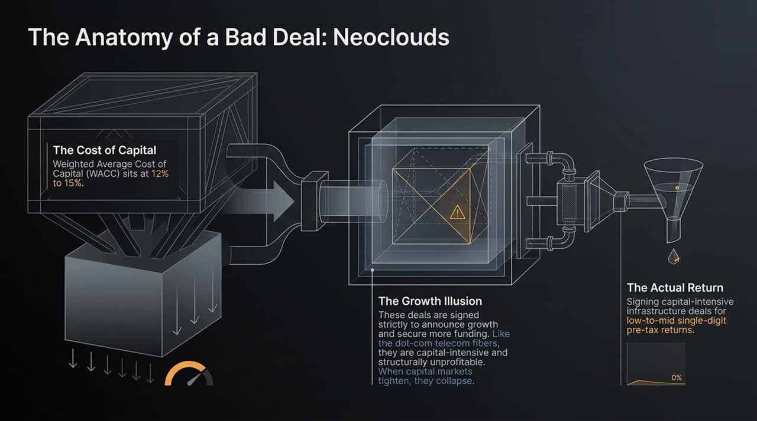
Notes:
Speaker Script:
To understand where structural vulnerabilities lie in the AI buildout, let's look at the Neocloud business model.
These entities face a Weighted Average Cost of Capital (WACC) between 12% and 15%. Yet, in order to show rapid growth and capture market share, they are signing long-term infrastructure deals yielding only low-to-mid single-digit pre-tax returns.
Just like the telecom and fiber firms of the dot-com era, these deals are executed to announce headline revenue growth and raise additional capital. They are capital-intensive, low-return, and structurally unprofitable. As soon as private or public debt markets tighten, these business models experience liquidity crises.
Key Talking Points:
Unviable capital economics of Neocloud data center deals.
Disconnect between WACC (12–15%) and pre-tax returns (low-to-mid single digits).
Growth illusions driving structurally unprofitable infrastructure commitments.
Podcast Reference & Context:
Chanos explains: "They're doing deals for low single-digit, mid single-digit pre-tax returns on capital who have weighted average cost of capital of 12-15%. And they're doing it because it's growth... When capital markets tighten up, they collapse."

Slide 11
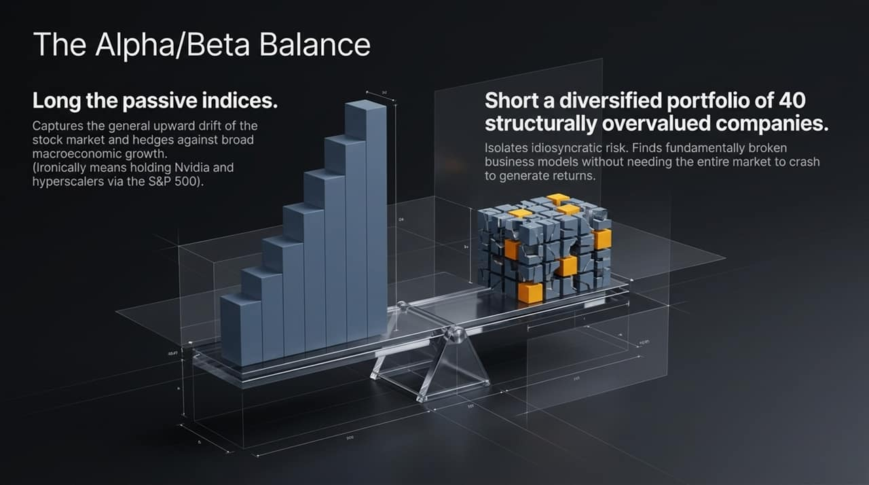
Notes:
Speaker Script:
How does a professional short seller manage market risk during an ongoing bull market? Through an Alpha/Beta balanced portfolio construction.
Rather than betting on an outright market crash, Chanos maintains long exposure to broad passive indices. This captures general market upward drift and hedges against macro growth (which ironically means holding companies like Nvidia via index weightings).
On the short side, he holds a highly diversified basket of ~40 individual overvalued names. This structure isolates idiosyncratic business model flaws. Even if the broader S&P 500 continues upward, single-stock failures generate alpha independently of broad market movements.
Key Talking Points:
Combining long index exposure with a diversified basket of short positions (~40 names).
Holding index market beta while isolating idiosyncratic downside alpha.
Why short sellers do not need the entire market to crash to generate positive returns.
Podcast Reference & Context:
Chanos states: "We're long the market and short a portfolio of 40 what we think are structurally overvalued situations... A portfolio of 40 names goes a long way in diversifying away idiosyncratic short-side risk."

Slide 12
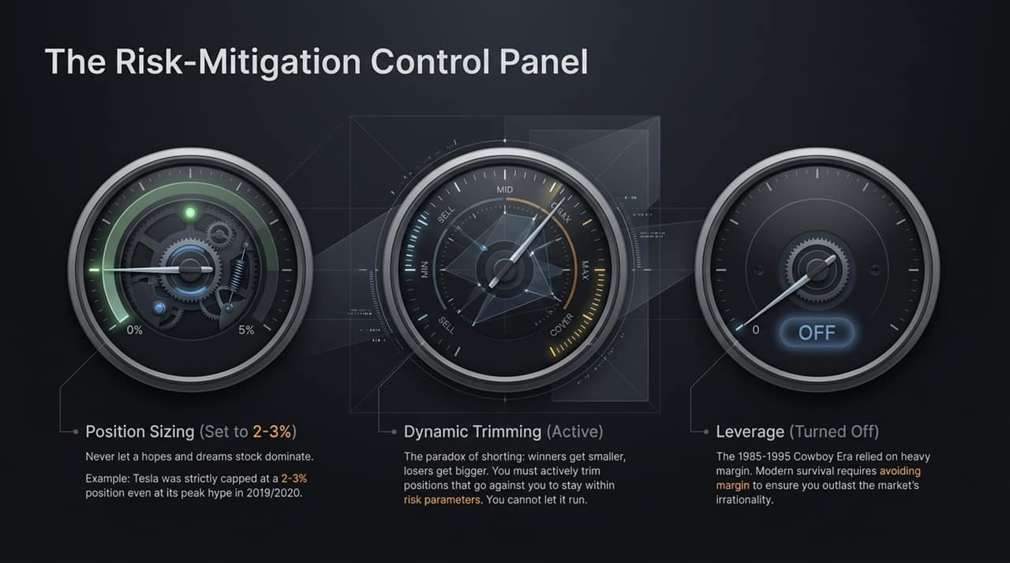
Notes:
Speaker Script:
"Short selling contains an inherent mathematical paradox: when a stock you short goes down, it becomes a smaller percentage of your portfolio; when it goes against you and rises, it becomes a larger percentage.
To survive, a control panel of strict risk rules is mandatory:
Position Sizing: Cap speculative or high-volatility shorts at 2–3%. For example, Chanos maintained Tesla at a maximum 2–3% capped weighting even during its steep 2019–2020 rally.
Dynamic Trimming: Actively trim positions that rise against you to enforce risk parameters. Never let a losing short run unchecked.
Zero Margin Leverage: Unlike the 'cowboy era' of the 1980s, modern short survival requires eliminating margin leverage so you cannot be forced out during temporary market irrationality.“
Key Talking Points:
Strict position sizing rules (2–3% max cap per short position).
The short seller's paradox: Winners shrink, losers grow.
Active dynamic trimming and eliminating margin leverage.
Podcast Reference & Context:
Chanos notes: "Tesla was a 2 to 3% position during that period... you have to use dynamic risk mitigation. If something's going against you on the short side, you can't just let it run. You have to trim it... We were cowboys from 1985 to 1995 on margin... now we run hedged without margin."

Slide 13
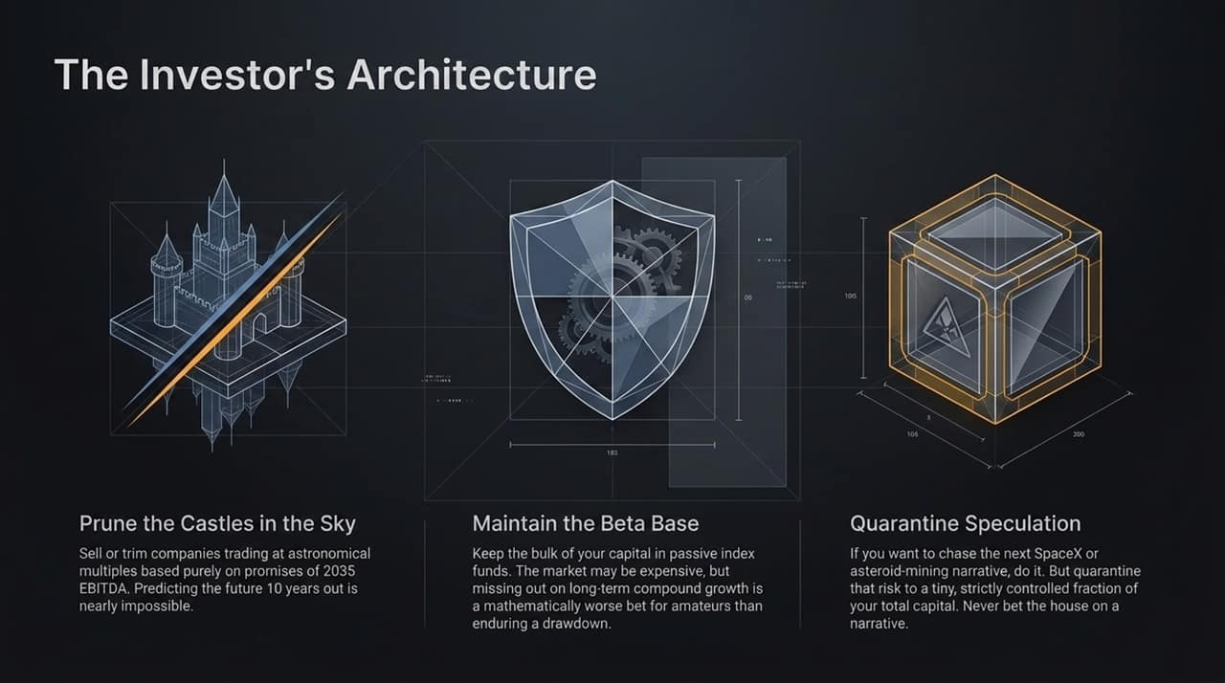
Notes:
Speaker Script:
"To conclude, what actionable advice does this analysis offer for individual and institutional investors today?
First: Prune the Castles in the Sky. Step away from companies where valuation depends on promises of profitability in 2030 or 2035. Predicting business models a decade out is extraordinarily difficult, and these stocks carry severe drawdown risk.
Second: Maintain your Beta Core Base. Do not pull all your money out of broad index funds simply because the market feels expensive. For most investors, missing out on long-term compound growth is mathematically worse than enduring temporary drawdowns.
Third: Quarantine Speculation. If you want to speculate on early-stage narratives or moonshots, do so—but strictly quarantine that capital to a small fraction (e.g., 5%) of your total wealth. Never bet your primary portfolio on a speculative story."
Key Talking Points:
Pruning 'Castles in the Sky' (stocks valued on 2035 EBITDA projections).
Preserving the passive index core base for long-term compound growth.
Quarantining speculative capital to a strict, non-critical portfolio percentage.

Slide 14
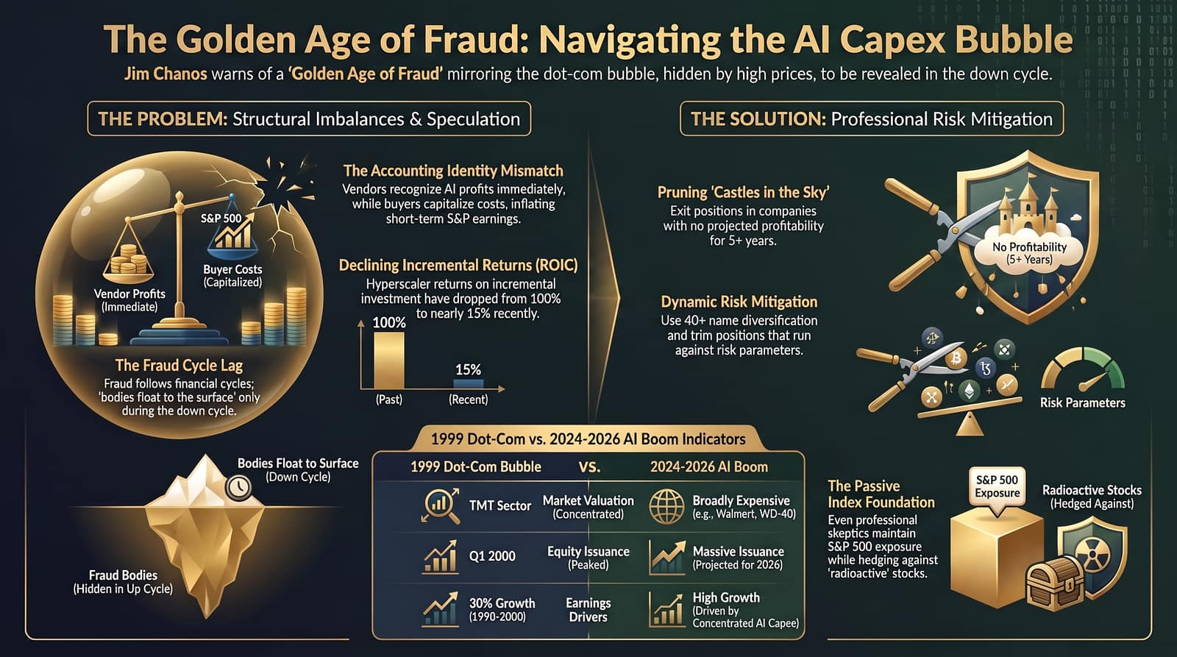
Notes:
Speaker Script:
To wrap up our dossier, this summary slide synthesizes the key themes we've covered:
On the left, we have The Problem: structural accounting identity mismatches inflating reported earnings, declining incremental returns on capital (ROIC dropping from 100% to 15%), and hidden corporate malfeasance that will only be exposed when the financial cycle turns.
In the center, we see how today's indicators compare to 1999: where 1999 featured concentrated tech valuations, today's market is broadly expensive across non-tech sectors as well.
On the right is The Solution: Maintain your passive index core, aggressively prune zero-profit long-dated narratives, dynamically manage position risks, and never allow narrative hype to override basic corporate finance discipline.
Thank you, and I am happy to open the floor to Q&A.
Key Talking Points:
Summary matrix connecting structural market problems to portfolio solutions.
Review of accounting mismatches, ROIC decay, and bubble indicators.
Final takeaway on managing portfolio risk through discipline and diversification.

